Slide 1
Unit 3 Review Game

Slide 2
Question #1
If the Federal Reserve wanted to stimulate the U.S. economy and reduce unemployment, it could …. ( 1 example and why)

Slide 3
Answer
Decrease Interest Rates- encouraging more consumer and business spending
Decrease Reserve Requirements- Allowing more money to be loaned out from the banks
Decrease Interest on Reserves- Allowing for more money in banks
Buy government bonds

Slide 4
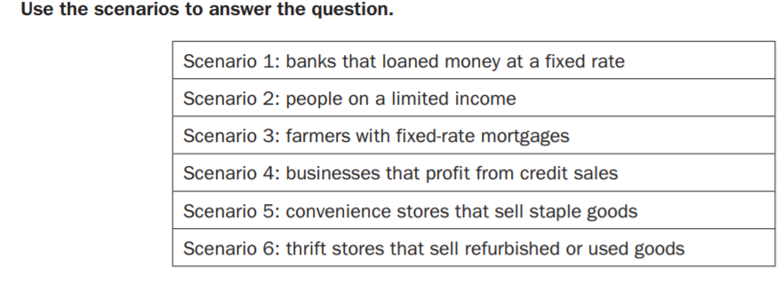
Which two scenarios would be most negatively affected by unanticipated Inflation?

Slide 5
Answer #2
A and B

Slide 6
Question #3
In year 1, the cost of the market basket was $760. In year 2, the cost of the same basket was $800. What was the consumer price index for year 2?

Slide 7
Answer #3
CPI=105

Slide 8
Question #4
What type of unemployment is represented in this scenario:
A computer programmer has been laid off during an economic downturn

Slide 9
Answer # 4
Cyclical Unemployment

Slide 10
Q#5
If aggregate demand and real GDP are slowly beginning to rise and the unemployment rate is just beginning to fall which part of the business cycle would we most likely be in?

Slide 11
A#5
The economy is in recovery and in expansionary phase

Slide 12
Q#6
What is the GDP for nation X given the following
Government expenditures= 1.3 million
Consumer expenditures= 4.2 million
Investment expenditures=1.6 million
Exports = 5 million
Imports= 6.7 million

Slide 13
A#6
5.4 million

Slide 14
Q#7
What is the relationship between a budget deficit and the national debt?

Slide 15
A#7
A budget deficit adds to the size of the national debt.

Slide 16
Q#8
Assume the reserve requirement is 25 percent. A bank has 390,000,000 in deposits, how much can they LOAN out?

Slide 17
A#8
292,500,000

Slide 18
Q#9
In which situation might the Federal Reserve
buy government securities or lower its discount rate?

Slide 19
A#9
During a recession

Slide 20
Q#10
How is monetary policy different from fiscal policy?

Slide 21
A#10
Monetary policy involves the money supply, while fiscal policy involves government taxing and spending decisions.

Slide 22
Q#11
What is GDP ? (formula AND definition )

Slide 23
A#11
Gross Domestic Product - The total value of a country’s annual output of goods and services for final use.
C+I+G+(X-N)= GDP

Slide 24
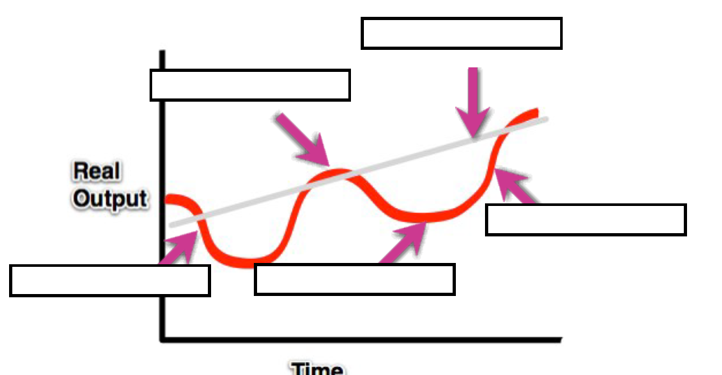
Q#12
Long run trend of RGDP
B
D
A
C

Slide 25
A#12
A- contractionary
B- Peak
C- Trough
D- Expansionary

Slide 26
Q#13
Define Frictional unemployment

Slide 27
A#13
experienced by individuals during the period between leaving one job and taking another.

Slide 28
Q#14
Winter hits early! Pools, beaches, and rivers are forced to shut down for the season.
All major hotel chains and taxi companies announce massive layoffs due to dramatic decrease in travel.
CNN reports increased number of people with MBAs and tax experience are leaving current jobs to pursue higher paying jobs in the health care industry.

Slide 29
Seasonal
Cyclical
Frictional

Slide 30
Q#15
Calculate the % inflation from 2014 to 2017 given the following :
Market Basket 2014- 18,000
Market Basket 2017- 22,000

Slide 31
A#15
22%

Slide 32
Q#16
Calculate the Unemployment rate with the following information
Employed- 4,500
Unemployed- 645
Not looking for work- 201

Slide 33
A#16
12.5%

Slide 34
Q#17
Which of the following would contribute to GDP AND what part of GDP
You spend $55 on a new pair of jeans.
You buy a home built in the 1950s.
Your grandmother receives a $100 Social Security check.
You buy a 2000 Ford Mustang from your economics teacher.

Slide 35
A#17
Only the 1st one does and it is consumer expenditures

Slide 36
Q#18
Name the 4 Monetary Tools

Slide 37
A#18
Open Market Operations
Discount Rate
Interest on Reserves
Reserve Requirement

Slide 38
Q#19
Calculate the % change of Real GDP given the following
2001- nominal GDP 12 million
2002 nominal GDP 18 million

Slide 39
A#19
50%

Slide 40
Q#20
What are the three functions of Money?

Slide 41
A#20
Store of Value
Medium of Exchange
Unit of Account

Slide 42
Q#21
Which function of money is represented by the following? ‘
At the department store last week, you bought Mr. Kaddah a birthday present for $21.25. You paid in cash and gave the cashier a twenty, a one , and a quarter.

Slide 43
A#21
Medium of Exchange

Slide 44
Q#22
What function of money is explained in the following scenario ?
Last year, you sold your Pokemon collection and got $500 cash. You’ve been saving that money in your piggy bank so that you can buy a car in a few year.

Slide 45
A#22
Store of value

Slide 46
Q#23
What function of money is represented by the following ?
You are deciding whether to buy half a dozen donuts for $5.00 or the dozen donuts for $8.50.

Slide 47
A#23
Unit of Account

Slide 48
Q#24
Market Basket 1977= $7000
Market Basket 2015= $8001
CPI in 2015 =
Inflation Rate=

Slide 49
A#24
CPI – 114
Inflation 14%

Slide 50
Q#25

Slide 51
A#25
Which part of GDP is represented in the following
You spend $7.00 to attend a movie.
The government increases its defense expenditures by $1,000,000,000.
You buy a new Toyota that was made in Japan
An accountant pays a tailor $175 to sew a suit for her. _____

Slide 52
A#25
1. C
2. G
3. Does not count
4. C or I

Slide 53
Q#26
What are the three groups that make up the Federal Reserve ?

Slide 54
A#26
(12 Districts, Federal Open Market Committee (FOMC), and Board of Governors

Slide 55
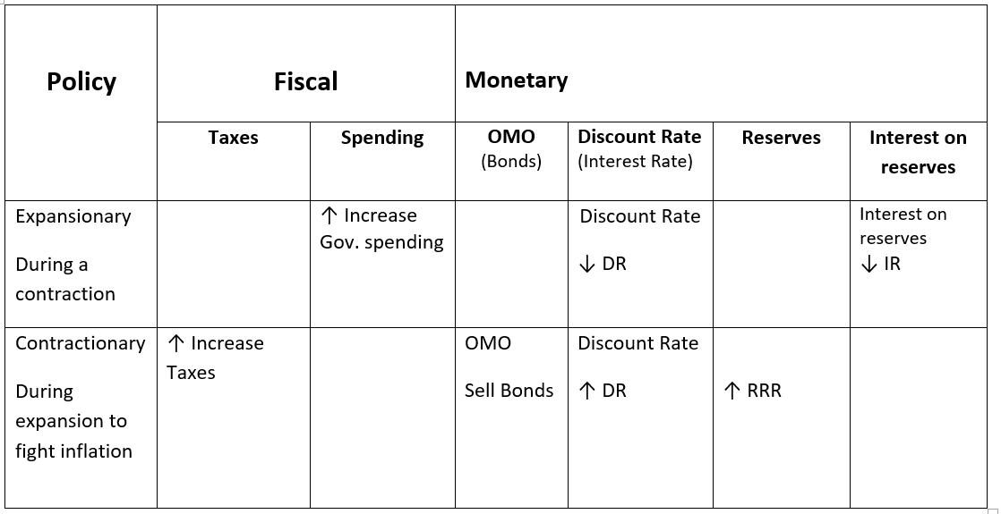
Q#27

Slide 56
A#27
Policy | Fiscal |  | Monetary
 | Taxes | Spending | OMO (Bonds) | Discount Rate (Interest Rate) | Reserves | Interest on reserves
Expansionary During a contraction | ↓ Lower Taxes (Consumers & Businesses) | ↑ Increase Gov. spending | OMO Buy Bonds | Discount Rate ↓ DR | Reserve Requirement Ratio ↓ RRR | Interest on reserves ↓ IR
Contractionary During expansion to fight inflation | ↑ Increase Taxes | ↓ Decrease Gov. spending | OMO Sell Bonds | Discount Rate ↑ DR | ↑ RRR | ↑IR

Slide 57
Q#28
What would be happening in the business cycle during expansionary phase? ( at least 2 examples)

Slide 58
A#28
Expansion
Business investments increase
Interest rates go from low to high
Consumer confidence increases
Low unemployment
Inflation may rise

Slide 59
Q#29
What would be happening in the business cycle during contractionary phase? ( at least 2 examples)

Slide 60
A#29
Drop in business spending
High unemployment (6 - 10% in recession)
Interest rates go from high to low
Consumer confidence
  Saving for a rainy day
Deflation may occur

Slide 61
Q#30
How do we calculate the unemployment rate?

Slide 62
A#30
Unemployed/ labor force

