Slide 1
Trade Barriers

Slide 2
Tariffs
A tax or duty to be paid on imports or exports
Pros- more money collected for gov’t; protecting domestic producers of the good
Cons- Higher prices for consumers

Slide 3
Quotas
Limits the # or monetary value of a good that can enter a country
Pros- benefit domestic producers by limiting the number of foreign goods with which they must compete
Cons- consumers who want the imported good cannot get it once the quota is met no matter how high a price they are willing to pay

Slide 4
Embargo
complete prohibition against bringing a certain good into a country.
Pros- Could influence the other country to behave the way you want them to
Cons- individuals and firms in the embargoing country can no longer enjoy the goods the embargoed country produces and may encounter higher prices from less competition in the market

Slide 5
Standards
Minimum qualifications/ requirements for a good
Pros- can benefit domestic consumers by protecting them from substandard or dangerous products
Cons- Some countries impose unattainable standards for foreign producers simply to force them out of the domestic market despite the products not posing any threat to domestic consumers. This hurts domestic consumers by increasing prices and hurts the foreign producer who has lost a market for the product

Slide 6
Subsidies
Government payment to a particular domestic industry
Pros- benefit domestic producers by allowing them to compete at the lower market price established by their foreign competition. keeps prices low for domestic and foreign consumers, protects domestic jobs, and helps firms stay profitable
Cons- damage industries and workers in other countries that would have a comparative advantage in production if the subsidy were not in place

Slide 7
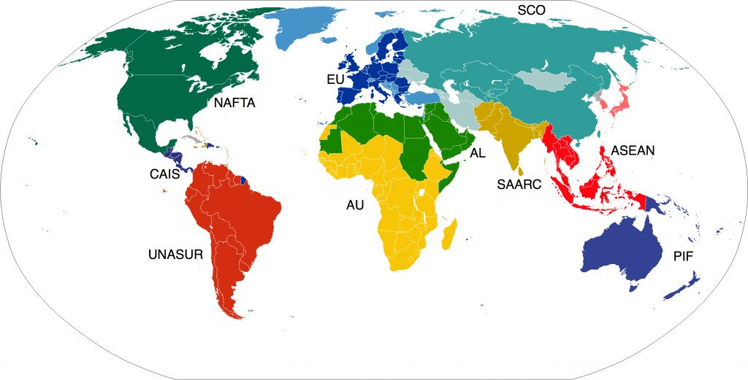
Trading Blocs
Trading blocs refer to free trade agreements among countries in a region. The goals for trading blocs may include reducing or eliminating trade barriers, increasing specialization and efficiency in production, allowing free movements of workers within the bloc, establishing a common currency, and/or coordinating infrastructure projects to facilitate efficient trade among members
Examples- NAFTA, EU, ASEAN

Slide 8
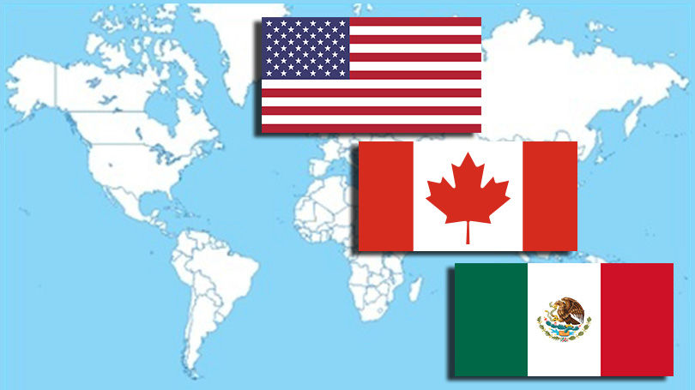
NAFTA
The North American Free Trade Agreement (NAFTA) is an agreement among the United States, Canada, and Mexico. This agreement allows for the free trade of many goods among the countries, encourages efficiency and specialization in production, and involves coordination among countries. NAFTA countries do not share a common currency or border free movement of goods and people.
USMCA- is a pending agreement to replace NAFTA

Slide 9
ASEAN
The Association of Southeast Asian Nations (ASEAN) is a trade bloc of 10 Southeast Asian countries. Like the NAFTA countries, the ASEAN countries promote free trade, specialization, and coordination among members, but do not have a common currency or border-free travel.

Slide 10
EU
the European Union (EU) had 28 member countries. Of the 28, 19 use the common currency the Euro and 26 enjoy the border-free movement of goods and people from country to country. Currently, the United Kingdom intends to leave the European Union within about two years

