Slide 1
Stock Market Project
Research and Information Guide

Slide 2
Yahoo Finance
https://finance.yahoo.com/industries
This is a great resource to find all of your information in one place
Google Finance is also another great tool to use.
https://www.google.com/search?stick=H4sIAAAAAAAAAOPQeMSozC3w8sc9YSmpSWtOXmMU4RJyy8xLzEtO9UnMS8nMSw9ITE_lAQCCiJIYKAAAAA&q=finance&tbm=fin

Slide 3
By clicking on the search bar you can look for companies by name
If you are not sure what companies you want to use, you can click on industries to see the top trends in various areas.

Slide 4
This is the percent change for the day to that point.
This is the closing price from the day before. This is the price we will use for buying and eventually selling.
This number shows the current price for 1 share of the company.
By default this graph shows you the ups and downs for the day. You should look at longer trends by clicking the other options at the top in order to get a better idea of the stock.
This shows the 52 week (1year) high and low price

Slide 5
To read more about your company and for journal entry #1, you can click the news tab to read the latest news about that company.
If you are interested in other companies that are similar to the one you are looking up, you can look to the right and find this section to have a quick comparison .

Slide 6
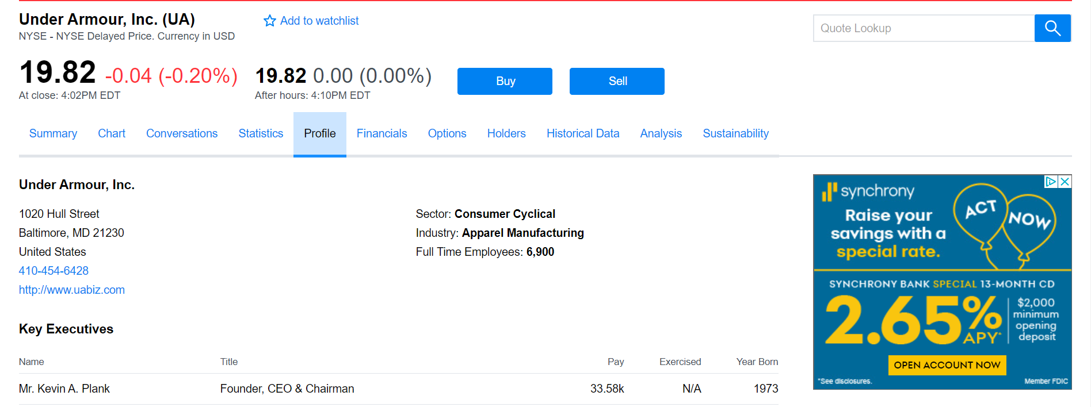
The profile tab will give you more information about the company including a description. This is useful for your company research portion.

Slide 7
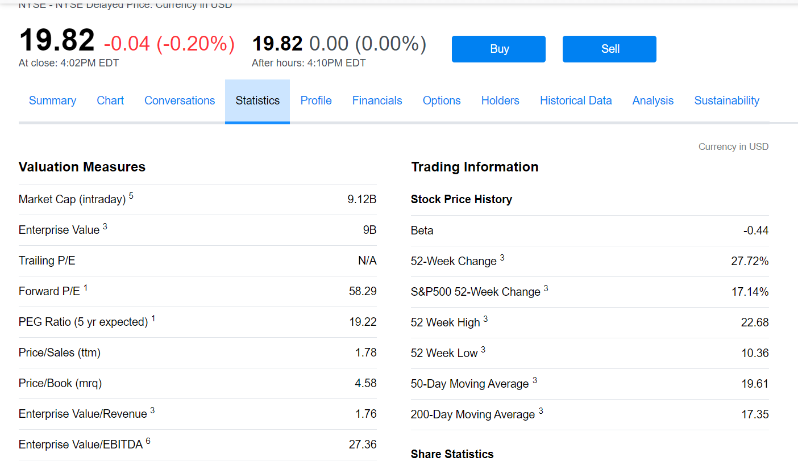
The statistics tab will give you more information that you will find helpful when completing journals.

