Slide 1
What is GDP?
What are the components of GDP ?

Slide 2
Real GDP
Real GDP is adjusted for changing prices and inflation
Without adjusting for inflation, nominal GDP could be due to an increase in prices

Slide 3
Economic Growth
How much has the Real GDP changed from one time period to the next?
Expressed in % terms.
Calculate: Year2-Year1 x100=
        Year 1

Slide 4
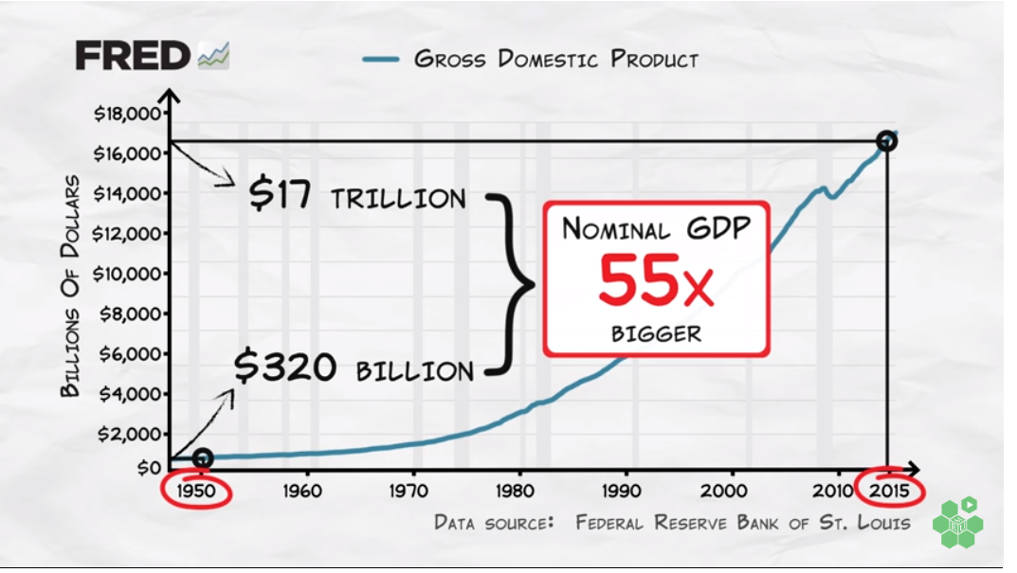
Nominal GDP from 1950-2015

Slide 5
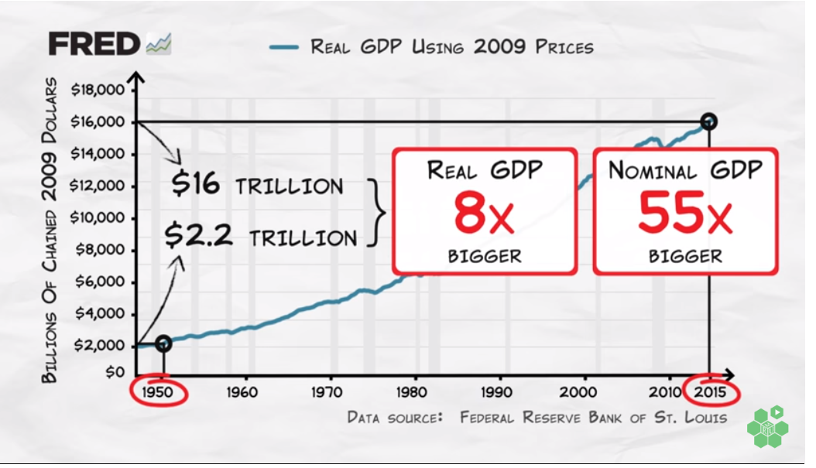
Real GDP

Slide 6
Aggregate Demand
AD = Total amount of goods and services people in an economy are willing to buy.
AD is made up of Real GDP (C+I+G+(x-m) Anything that changes these shifts AD
Downward sloping because of
1. wealth effect- Price goes up then people buy less; Price down- buy more
2. Interest rate effect- Price up then higher interest rates; Price down interest rates down

Slide 7
Aggregate supply
AS = Total amount of goods and services that all producers in an economy are willing to provide
When price level increases, producers will supply more
Resource's prices, productivity, government action all cause shifts in AS

