Slide 1
Unit 2: Microeconomics

Slide 2
Circular Flow Model

Slide 3
Circular Flow Diagram
This shows us the relationships that exist between household and business in the economy

Slide 4
Households role in the economy
Resource(factor) market- own the productive resources (factors of production) in the circular flow model. They sell land, labor, capital and entrepreneurship to businesses for income payments.
Land--- Rent Labor--- Wages Capital--- Interest Entrep.---Profit
Product Market- consumers of goods and services. Buy goods and services from businesses. They spend the income they earned in Resource Market to buy these goods and services.

Slide 5
Businesses role in the economy
Resource Market- consumers of the productive resources (factors of production). They purchase the use of land, labor, capital, and entrepreneurship using revenue they earn in the Product Market.
Product Market- producers of goods and services. They sell goods and services to households to earn revenue .

Slide 6
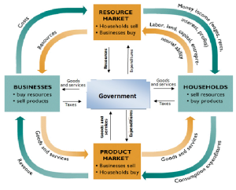
Governments Role in Circular Flow
Product Market- consume products from businesses (i.e. Firetrucks) and pay for them.
Resource Market- buy resources (i.e. Teachers) in the resource market and pay for them.
Businesses- Provides public goods (i.e. roads, bridges, fire stations) and subsides. They then collect taxes from businesses.
Households- Provides public goods and welfare services. Collects taxes to pay for these

Slide 7
What goes where?

Slide 9
A Quick Review of Decision Making
We make a decision if…
If I like a product and cost of it goes up, what are the chances that I will buy more of it?
What happens to the benefit as I get more of something?

Slide 10
Demand: Desire, ability, and willingness to buy a product
The law of demand says that as the price of a good rises the quantity of the good consumers are willing and able to buy will decrease
Inversely related
Low price= High quantity
High price= Low quantity
Quantity Demanded- The amount of a good that buyers are willing and able to purchase at a given price. (SPECIFIC NUMBER)

Slide 11
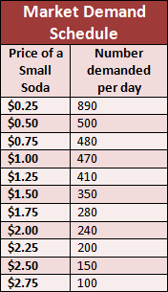
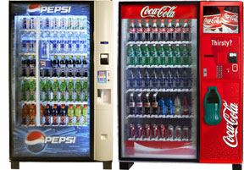
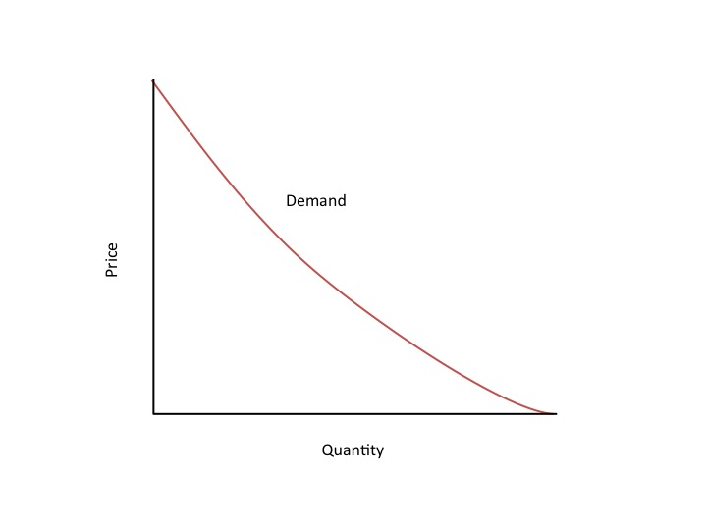
Demand Schedule & Curve
Demand schedule shows the relationship between the price of the good and the quantity demanded.
Demand curve is a graph of the relationship between the price of a good and the quantity demanded

Slide 12
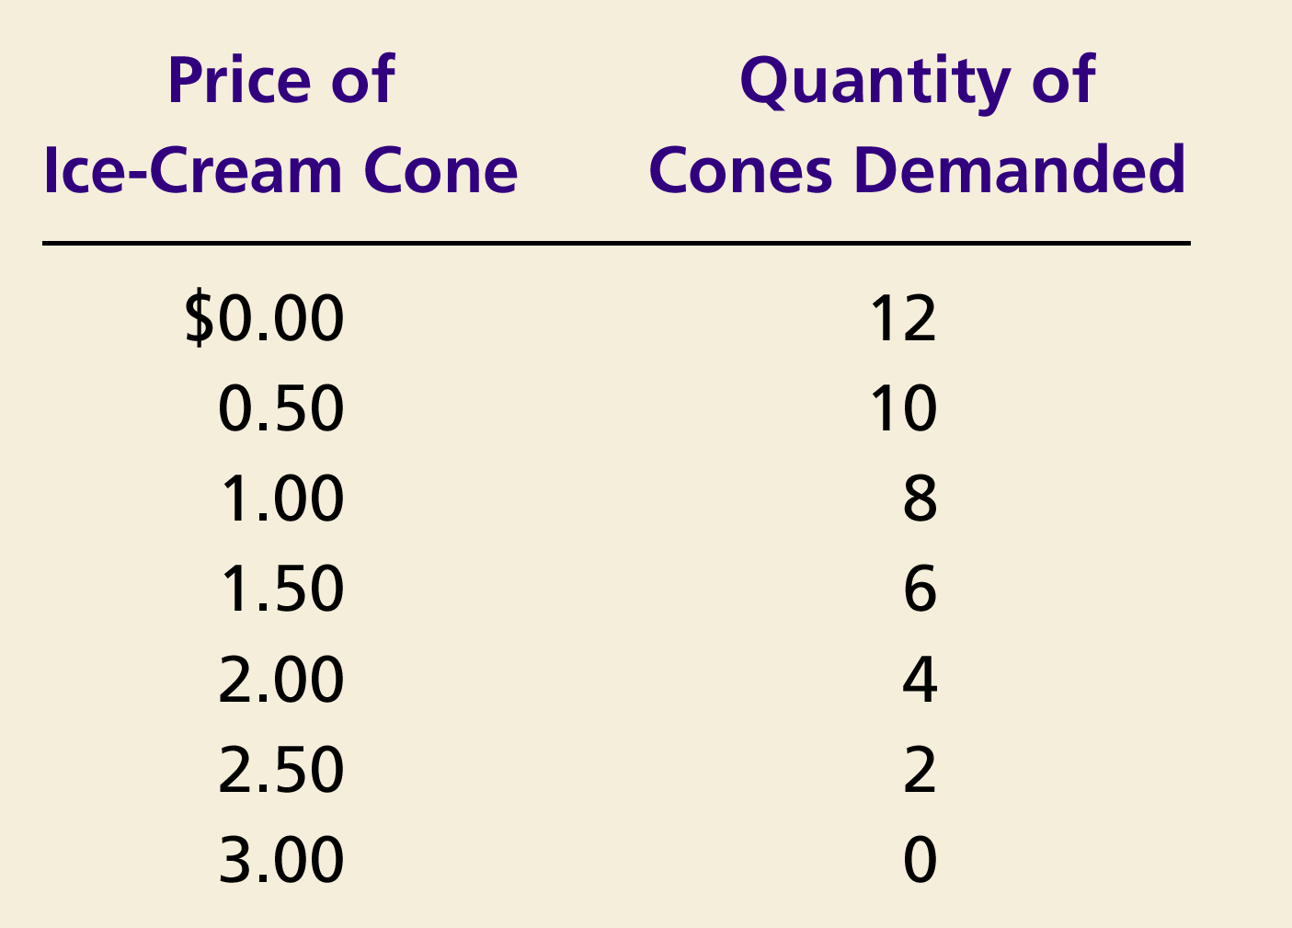
Demand Curve for Ice Cream Cones
Price of
Ice-Cream Cone
$3.00
2.50
1. A decrease
2.00
in price
...
1.50
The demand curve slopes downwards from left to right (a negative slope), indicating the Law of Demand.
1.00
0.50
0
1
2
3
4
5
6
7
8
9
10
11
12
Quantity of
Ice-Cream Cones
2.
...
increases quantity
of cones demanded.

Slide 13
Shifts and Changes in Demand
Changes in Quantity Demanded (Qd)
If there is a change in PRICE for the product, then there is a change in the QUANTITY DEMANDED (Qd)
This causes movement ALONG the demand curve.

Slide 14
Determinants of Demand
Change in Demand
Income of consumers
Number of consumers
Substitute price change
Expectations
Complement price change
Tastes or preferences
This results in a shift in the demand curve, either to the left or right.
Causes a change that alters the quantity demanded at every price.

Slide 15
Shifts in the Demand Curve
An increase is always to the right and a decrease is always to the left.
Price of
Ice-Cream
Cone
Increase
in demand
Decrease
in demand
Demand
curve,
D
2
Demand
curve,
D
1
Demand curve,
D
3
0
Quantity of
Ice-Cream Cones

Slide 16
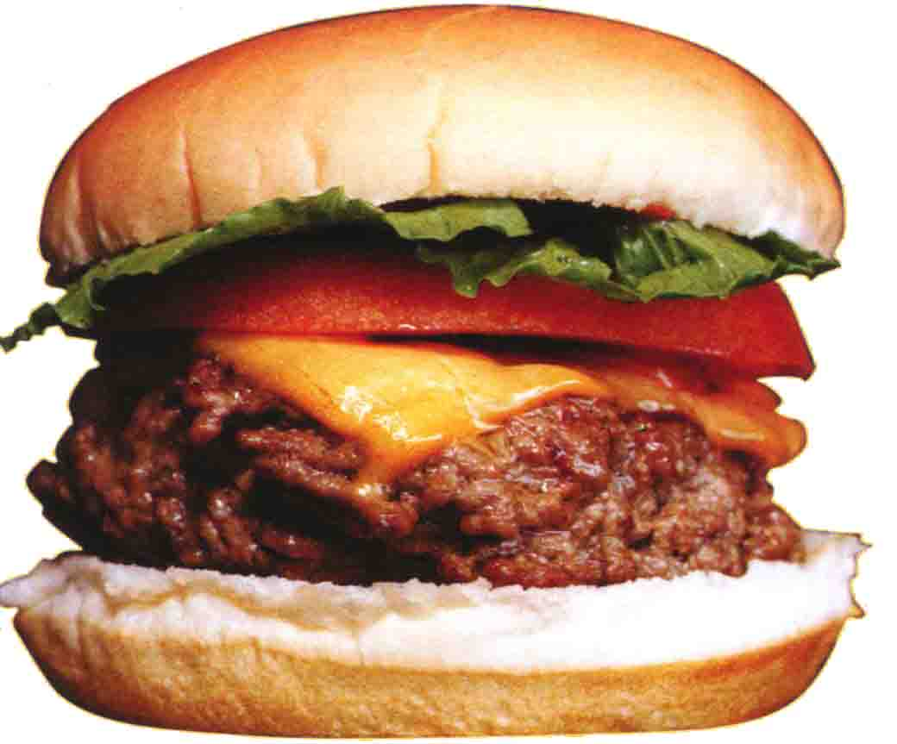
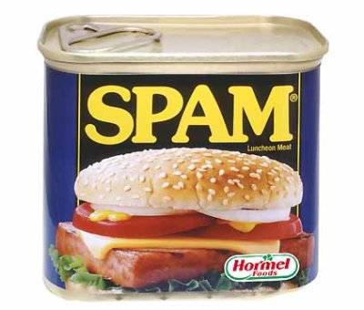
Shifts and Changes in Demand cont.
A closer look at changes in income
Normal Good
A good that consumers
demand more when their
incomes increase
Inferior Good
A good that consumers
demand less when their
incomes increase

Slide 17
Consumer Income Normal Good
Price of Hamburgers
$3.00
An increase in income...
2.50
Increase
in demand
2.00
1.50
1.00
0.50
D₂
D₁
Quantity of Hamburgers
0
1
2
3
4
5
6
7
8
9
10
11
12

Slide 18
Consumer Income Inferior Good
Price of Spam
$3.00
2.50
An increase in income...
2.00
Decrease
in demand
1.50
1.00
0.50
D₁
Quantity of Spam
0
1
2
3
4
5
6
7
8
9
10
11
12

Slide 19
Supply
Supply
The schedule of quantities that would be offered for sale at all possible prices that could prevail in the market. (NOT A SPECIFIC NUMBER)
Quantity Supplied
Amount offered for sale at a given price. (SPECIFIC NUMBER)
Law of Supply
The law of supply states that, other things equal (Ceteris Paribas), the quantity supplied of a good rises when the price of the good rises.
In other words: Low price = Low quantity High price = High quantity

Slide 20
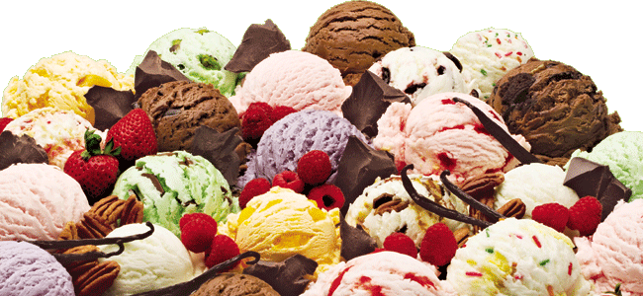
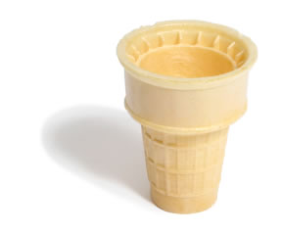
Supply Schedule
Table that shows the relationship between the price of the good and the quantity supplied.
Supplied

Slide 21
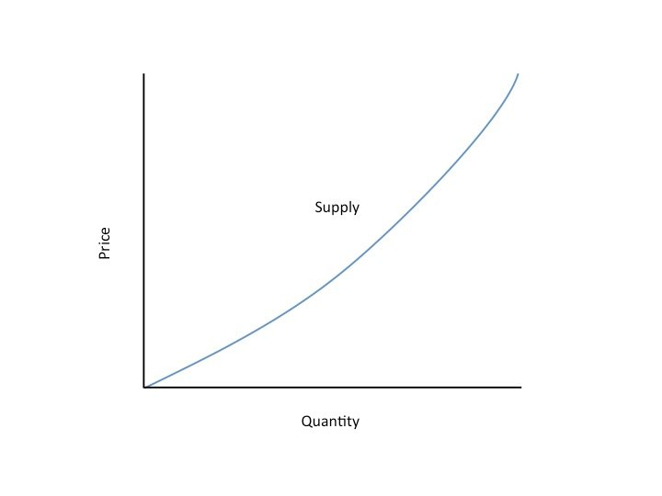
Supply Curve
Supply Curve
The graph of the relationship between the price of a good and the quantity supplied.

Slide 22
The supply curve slopes upwards from left to right (a positive slope), indicating the Law of Supply.
Price of
Ice-Cream
Supplied
Cone
$3.00
2.50
1. An
increase
in price
...
2.00
1.50
1.00
0.50
0
1
2
3
4
5
6
7
8
9
10
11
12
Quantity of
Ice-Cream Cones
2.
...
increases quantity of cones supplied.

Slide 23
Shifts and Changes in Supply cont.
Changes in Quantity Supplied (Qs)
If there is a change in PRICE for the product, then there is a change in the QUANTITY SUPPLIED (Qs) for that product.
This a movement ALONG the supply curve.

Slide 24
Change in Quantity Supplied
Price of Ice-Cream Cone
S
B
$3.00
A rise in the price of ice cream cones results in a movement along the supply curve.
A
1.00
Quantity of Ice-Cream Cones
0
1
5

Slide 25
Shifts and Changes in Supply cont.
Change in Supply
# of producers
Government action ( taxes, subsidies and regulations )
Resource prices
Expectations
Education
Technology changes
A shift in the supply curve, either to the left or right.
Causes a change that alters the quantity supplied at every price.

Slide 26
Again, an increase is always to the right and a decrease is always to the left.
Price of
Ice-Cream
Supply curve,
S
3
Supply
Cone
curve,
S
1
Supply
Decrease
curve,
S
2
in supply
Increase
in supply
0
Quantity of
Ice-Cream Cones

Slide 27
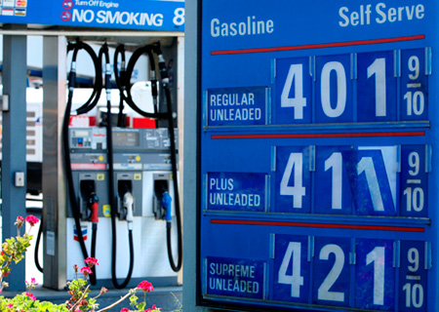
Essential Question 4
How are prices established in a perfectly competitive market?

Slide 28
Prices: Supply and Demand Combined
Why are prices good?
Neutral
They don’t favor the buyer or seller
Flexible
Reacts to change and adjusts
Efficient
Make decisions easily
Keeps shortages from occurring

Slide 29
Prices: Supply and Demand Combined cont.
What happens without prices?
Rationing
Government decides what is a fair amount
High administrative costs
Bureaucracy
Diminished incentive
Waste

Slide 30
Prices: Supply and Demand Combined cont.
How are prices determined?
What are you trying to reach?
Market Equilibrium
Situation in which prices are relatively stable and
Qs = Qd
Equilibrium Price
The price that balances Qs and Qd.
On a graph, it is the price at which the supply and demand curves intersect.
Equilibrium Quantity
The Qs and the Qd at the equilibrium price.
On a graph it is the quantity at which the supply and demand curves intersect.

Slide 31
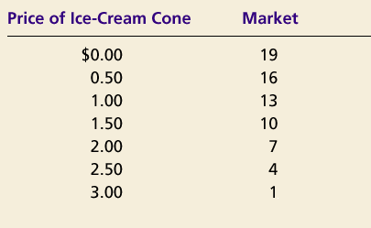
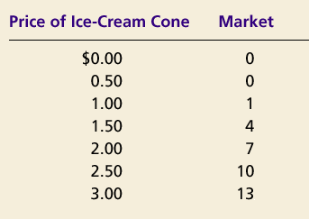
Prices: Supply and Demand Combined cont.
Demand Schedule
Supply Schedule
At $2.00, the quantity demanded is equal to the quantity supplied!

Slide 32
Prices: Supply and Demand Combined cont.
Price of
Ice-Cream
Cone
Supply
Equilibrium price
Equilibrium
$2.00
Equilibrium
Demand
quantity
0
1
2
3
4
5
6
7
8
9
10
11
12
13
Quantity of Ice-Cream Cones

Slide 33
Analyze Hamburgers
Show the change in supply or demand and say how the equilibrium price will change
1. New grilling technology cuts production time in half
2. Price of chicken increases
3. Price of hamburgers decreases
4. Price of ground beef triples
5. Human fingers found in multiple burgers.

Slide 34
Prices: Supply and Demand Combined cont.
Surplus
When price > equilibrium price, then quantity supplied > quantity demanded.
There is excess supply or a surplus.
Suppliers will lower the price to increase sales, thereby moving toward equilibrium.
How did American car companies respond to the recession?

Slide 35
Prices: Supply and Demand Combined cont.
Price of
Ice-Cream
Supply
Cone
Surplus
$2.50
2.00
Demand
0
4
7
10
Quantity of
Quantity
Quantity
Ice-Cream
demanded
supplied
Cones

Slide 36
Prices: Supply and Demand Combined cont.
Shortage
When price < equilibrium price, then quantity demanded > the quantity supplied.
There is excess demand or a shortage.
Suppliers will raise the price due to too many buyers chasing too few goods, thereby moving toward equilibrium.

Slide 37
Prices: Supply and Demand Combined cont.
Price of
Ice-Cream
Supply
Cone
$2.00
1.50
Shortage
Demand
0
4
7
10
Quantity of
Quantity
Quantity
Ice-Cream
supplied
demanded
Cones

Slide 38
Shifts and the Equilibrium Price
Shifts in Curves VS Movements along Curves
S VS Qs
A shift in the supply curve is called a change in supply.
A movement along a fixed supply curve is called a change in quantity supplied.
D VS Qd
A shift in the demand curve is called a change in demand.
A movement along a fixed demand curve is called a change in quantity demanded.

Slide 39
Shift in Supply
Price of
Ice-Cream
1. An increase in the
Cone
price of sugar reduces
S₂
the supply of ice cream. . .
S₁
$2.50
2.00
Initial equilibrium
2. . . . resulting
in a higher
price of ice
cream . . .
Demand
0
4
7
Quantity of
3.
. . .
and a lower
Ice-Cream Cones
quantity sold.

Slide 40
Shift in Demand
Price of
Ice-Cream
1. Hot weather increases
Cone
the demand for ice cream . . .
Supply
$2.50
New equilibrium
2.00
2. . . . resulting
in a higher
price . . .
D
D
0
7
10
Quantity of
3.
. . .
and a higher
Ice-Cream Cones
quantity sold.

Slide 41
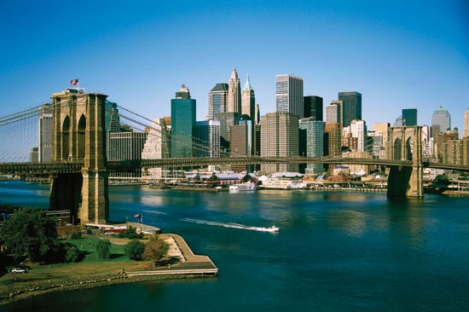
Essential Question 5
How do price floors and ceilings alter price and quantity?

Slide 42
Price Ceilings and Floors Tampering with the Laws of Economics
Price Ceiling
Maximum legal price that can be charged
Causes a Black Market to form
Why are scalpers able to make money at a football game?
Price Floor
Lowest legal price to be paid for a good
Why could the minimum wage be considered a bad thing?
Why is corn in everything we eat?

Slide 43
Effects of a Price Ceiling
Price
Supply
$7
$5
Shortage
Demand
0
4
7
10
Quantity
Quantity
Quantity
supplied
demanded

Slide 44
Effects of a Price Floor
Price of
Corn
Supply
Surplus
$3
$1
Demand
0
4
7
10
Quantity of
Quantity
Quantity
Corn
demanded
supplied

Slide 45
Examples?
Minimum Wage

Slide 46
Essential Question 5
How do price floors and ceilings alter price and quantity?

Slide 47
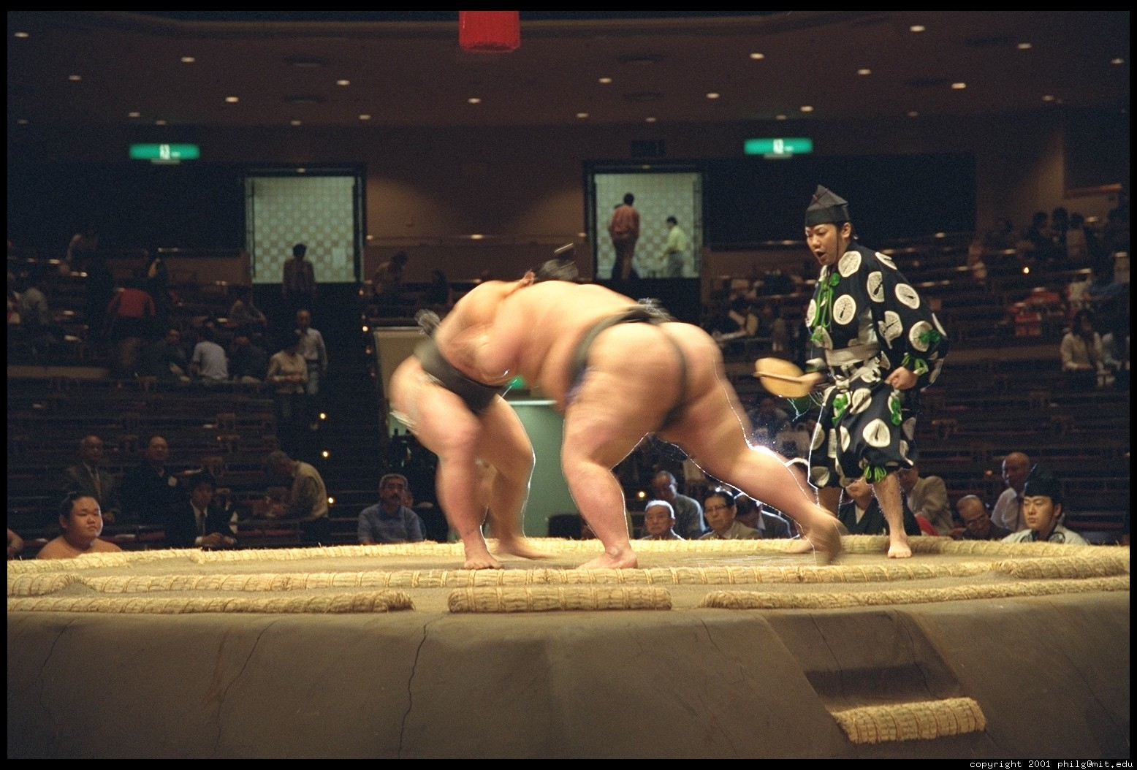
Essential Question 6
What factors affect the level of competition in various U.S. industries?

Slide 48
Competition and Market structures
Industry VS Firm
Firm
Individual producer
Industry
All producers collectively
4 types
Pure or Perfect Competition
Monopolistic Competition
Oligopoly
Monopoly

Slide 49
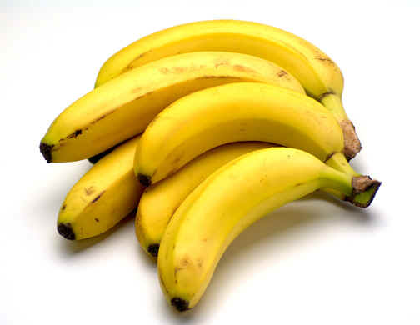
Pure Competition
Commodities Market
5 Conditions
1) Lots of buyers and sellers
So many that one buyer or seller cannot influence the market or the price
2) Buyers and sellers deal with identical products
No difference in quality, no such thing as a brand name, no need to advertise
3) Each buyer and seller acts independently
Lots of competition between everyone
4) Buyers and sellers are all reasonably well-informed
5) Buyers and sellers are free to enter and leave the market.
Few barriers to entering (regulations, taxes, expenses)

Slide 50
Pure Competition cont.
Since no firm or individual can influence the price, they must sell at whatever the market dictates based on the Equilibrium price and quantity
Maximize profits by finding a production where MC=MR given the market price.
Pure competition only takes place if all 5 conditions are met.

Slide 51
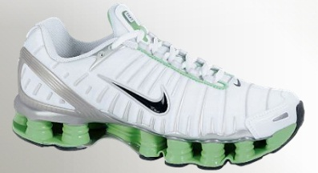
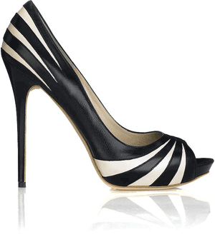
Monopolistic Competition
Shoes, Jeans
All conditions present except identical products
Firm tries to make product a little different to attract more buyers and monopolize a segment of the market
Do this through Product Differentiation
Products are similar, but different
This difference may be real or perceived
Non price Competition
Advertising or other campaigns try to convince buyers that products are better than others.
Make the consumer think that product is so special, nothing comes close to it. If this happens, firm can charge a higher price
What can a $ .50 aspirin do that a $ .1 can’t?

Slide 52
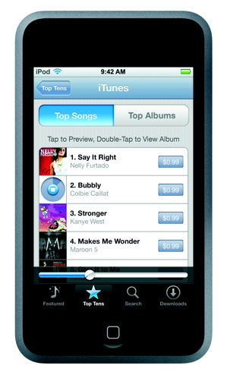
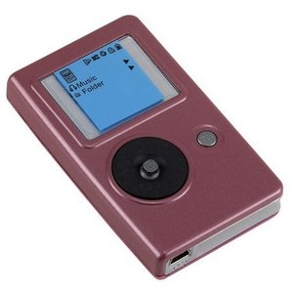
Monopolistic Competition cont.
Profit Maximization
Similar products generally sell within a narrow price range
Seller must raise and lower price within the range
VS

Slide 53
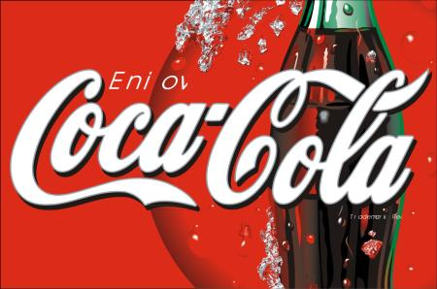
Oligopoly
Airlines, oil companies, car companies, soft drinks, fast food
Few large sellers dominate the market
One firm has a larger impact on supply and price
Further from pure competition than monopolistic competition
Usually large barriers to entry
Laws, regulations, expensive to start

Slide 54
Oligopoly cont.
Little independent behavior
Less competition means more influence in the market; therefore, when one firm does something, others react quickly.
Collusion And Cartels
Formal agreement to set prices or cooperate in other ways
Illegal
Price fixing
Agreement to charge the same or similar prices
Very illegal, but hard to prove

Slide 55
Oligopoly cont.
Pricing behavior
Since others react quickly to changes in price, price wars can occur
Series of price cuts that lead to unusually low prices
Why does every fast food restaurant have a dollar menu?
Raising or lowering prices can be risky
Price leadership
One firm sets the price and others follow because it controls so much of the market
Non price competition is used a lot in this type of market
Prices are usually higher than monopolistic competition and much higher than pure competition

Slide 56
Monopoly
Georgia power
One seller
Very few of these in U.S.
Americans do not like them
Usually can find a reasonably close substitute
New technology can lead to new products to compete with the monopoly

Slide 57
Monopoly cont.
Types of monopolies
Natural Monopoly
Market situation where costs are minimized by having a single firm produce the product
Utility companies
Franchise
Government gives permission to be a monopoly
Sometimes leads to lower costs
Economies of Scale
As a firm grows, it usually becomes more efficient at producing products
Geographic Monopoly
Monopoly based on location
Gas station in the middle of nowhere

Slide 58
Monopoly cont.
Types of monopolies
Technological monopoly
Special privilege given to those who invent a new product
Patent
Exclusive right to manufacture, use, or sell any new and useful art, machine, manufacturing process, or composition of matter, or any new and useful improvement thereof.
Copyright
Same thing as a patent only used for art or literary work
Government Monopoly
Business that the government owns and operates
Usually involves things people need that private businesses may not adequately provide
Police and fire protection, army

Slide 59
Essential Question 6
What factors affect the level of competition in various U.S. industries?

Slide 60
Essential Question 7
How does a purely competitive firm maximize profits?

Slide 61
Market Failures
Markets work best when…
There is adequate competition
Buyers/Sellers are well informed
Resources move freely
Prices reasonably reflect production cost
When these conditions are not met, market failures occur.

Slide 62
Market Failures
Examples
Inadequate competition
Dangers of monopolies
Artificial shortages and high prices
Inefficiency
Businesses gain political power
More competitive market = More fair
Businesses will tell on each other if they break the law, just like in sports
Inadequate information
Need information to be efficient
May not get the best buy/sell price

Slide 63
Market Failures
Examples cont.
Resource immobility
When large factories or military bases close, people may want to stay in city instead of moving to find a new job
Leads to artificially high price of labor in cities that need workers and artificially low price of labor in the cities former employees stay
Externalities
Economic side effect that either benefits or harms a 3rd party not directly involved in activity
Example: Building or expanding an airport, Car pollution
Considered a failure because their costs and benefits are not reflected in the price of the action
Negative: Actions harm 3rd party
Positive: Actions help 3rd party
Why do businesses and individuals pollute? How can we solve the pollution problem? Cap and trade? Taxes?

Slide 64
Market Failures
Examples cont.
Public Goods
Private companies won’t provide some things because they are not profitable
Examples: interstates, public buildings, missile defense systems
Eliminates the problem of free riders
Someone who gets to use a good or service who gets it for free
Sometimes decisions maybe made that ignore market forces. In other words, the government will build it even if it does not make economic sense to do so.
How do they get away with this?
Imagine splitting a check at a restaurant with a big party. How would this affect your decision to buy a dessert?

