Slide 1
Ideals of Democracy

Slide 2
Ideals of Democracy
The U.S. Government is based on 7 key principles:
Popular Sovereignty
Republicanism
Limited Government
Separation of Powers
Individual Rights
Checks and Balances
Federalism
These ideals are reflected in the Declaration of Independence and the U.S. Constitution

Slide 3
Popular Sovereignty
Government is created by and subject to the will of the people
That to secure these rights, Governments are instituted among Men, deriving their just powers from the consent of the governed, — That whenever any Form of Government becomes destructive of these ends, it is the Right of the People to alter or to abolish it, and to institute new Government – Declaration of Independence
Examples of Popular Sovereignty in the Constitution
  9th Amendment - The enumeration in the Constitution, of certain rights, shall not be construed to deny or disparage others retained by the people.
  10th Amendment -The powers not delegated to the United States by the Constitution, nor prohibited by it to the States, are reserved to the States respectively, or to the people.

Slide 4
Popular Sovereignty
People = Power
Do all citizens have equal power?
What factors determine how much power people possess?

Slide 5
Republicanism
Political theory that believes in representative government in which citizens can vote for people to represent their opinions and views.
Voters select candidates who best represent their opinions and views and those elected represent those constituents
Article 4 Section 4 of the U.S. Constitution - Republican Government. The United States shall guarantee to every State in this Union a Republican Form of Government, and shall protect each of them against Invasion; and on Application of the Legislature, or of the Executive (when the Legislature cannot be convened) against domestic Violence.

Slide 6
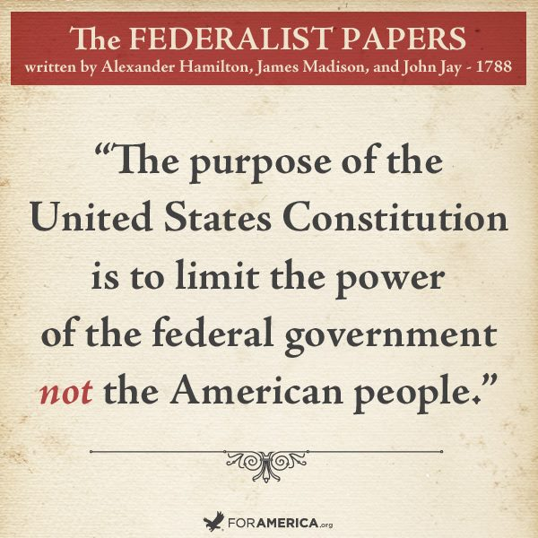
Limited Government
A limited government is one whose legalized force and power is restricted through delegated and enumerated authorities.
Government is not all powerful
Citizens and government must follow laws
Government has whatever limited powers the people choose to give it
  Collect Taxes
  Build Military
  Declare War
  Money/Banking System

Slide 7
Limited Government
Freedom of Speech
Right to Protest
Unreasonable Search and Seizure
Worth County Sheriffs Office
Government Surveillance

Slide 8
Separation of Powers
A fundamental principle of the United States government, whereby powers and responsibilities are divided among the legislative branch, executive branch, and judicial branch
Baron de Montesquieu – French philosopher who wrote The Spirit of the Laws
  Convinced that English liberties were based on the separation and balance of power between Parliament and the monarchy, a principle later embraced by the framers of the Constitution of the United States (see separation of powers; checks and balances)
Designed to prevent the majority from ruling with an iron fist. ... The separation of powers provides a system of shared power
Addressed throughout U.S. Constitution

Slide 9
Separation of Powers
Stolen Valor Acts of 2005 & 2013
U.S. v Alvarez

Slide 10
Checks and Balances
A system that allows each branch of government to limit the powers of the other branches in order to prevent abuse of power
Designed to allow each branch of government to check or limit the powers of the others in order to balance the power
Addressed throughout U.S. Constitution

Slide 11
Checks and Balances
Judicial Checks on Presidential Power
Riley v California (2014) – unlawful search of cell phone data
DACA (2018)

Slide 12
Federalism
Division of power between the national and state governments
The national government was conceived as one of limited and enumerated powers
The powers of states were simply everything left over after that enumeration
10th Amendment – “The powers not delegated to the United States by the Constitution, nor prohibited by it to the states, are reserved to the states respectively, or to the people.”

Slide 13
Federalism
Education
  State vs Federal roles in Education Policy
Marijuana Laws
  Marijuana still considered illegal by the federal government
  Many states legalizing or decriminalizing its use

Slide 14
Individual Rights
Guarantee individuals rights to certain freedoms without interference from the government or other individuals.
These rights are derived from the Bill of Rights in our United States Constitution. The Bill of Rights consists of the first ten amendments of the Constitution

Slide 15
Types of Representative Democracy
Participatory Democracy
Pluralist Democracy
Elite Democracy

Slide 16
Participatory Democracy
Emphasizes broad participation in politics and society
Citizens can have influence over policy decisions but politicians are still responsible for implementing them
Examples
  Town Hall Meetings
  Initiatives
  Referendums

Slide 17
Pluralist Democracy
Model in which no single group dominates politics and organized groups compete with each other to influence policy
Citizens still have influence over political decisions but work through groups formed around common causes
Groups compete for support from politicians who will advocate for their causes
Examples
  Interest Groups
    Big Tobacco
    NRA
    NOW

Slide 18
Elite Democracy
Model in which a small number of people, usually those who are wealthy or well-educated, influence political decision making
Participation in politics should be limited to a small group of highly informed individuals who are better equipped to make the best decisions for all citizens
Example
  Electoral College

