Slide 1
Fiscal Policy
Government Taxing and Spending

Slide 2
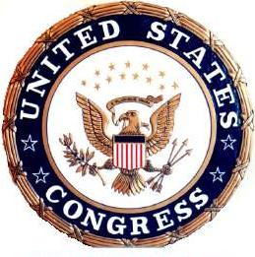

What is Fiscal Policy?
Government’s taxing and spending to change the economy
  Fix inflation
  Fix recessions and high unemployment

Slide 3
Taxes
Money we pay the government
Can increase or decrease
Problem: Inflation
  Government response: raise our taxes
Problem: Recession and high unemployment
  Government response: decrease our taxes

Slide 4
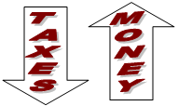

Problem: Recession and high unemployment
Solution: Decrease Taxes
If taxes decrease, we get to keep more of our money.
When we have more money, we spend more!
This is called

Slide 5

Problem: Inflation
Solution: Increase Taxes
If taxes increase, we get to keep less of our money.
When we have less money, we spend less
This is called
TAXES
MONEY
CONTRACTIONARY POLICY

Slide 6
Government Spending
Government’s get their money from us in the form of taxes. HOWEVER, if they change their spending, it does NOT mean TAXES have changed!
Government spending can increase or decrease.
When the government spends money, they are buying goods and services or resources from us. This means that when they spend, money comes to us.

Slide 7
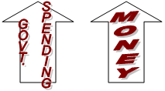
Problem: Recession and high unemployment
Solution: Increase spending
If government spending increases, they are buying more goods or resources from us, so we get more money.
When we have more money, we spend more!
This is called

Slide 8
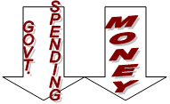
Problem: Inflation
Solution: Decrease spending
If government spending decreases, they are buying fewer goods or resources from us, so we get less money
When we have less money, we spend less
This is called
CONTRACTIONARY POLICY

Slide 9
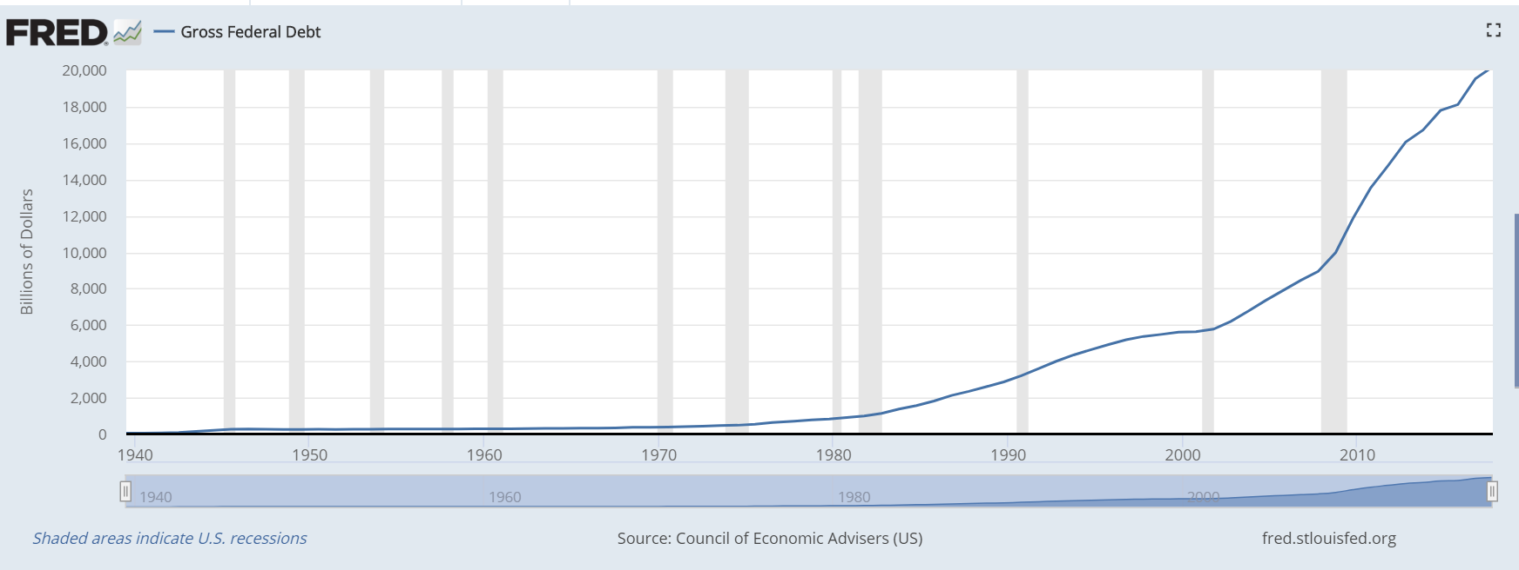
Debt vs Deficit
Deficit- Amount of money spend is less than money raised in a year
Debt- Total amount of money owed by the U.S. Government
National Debt - $21 Trillion Dollars

Slide 10
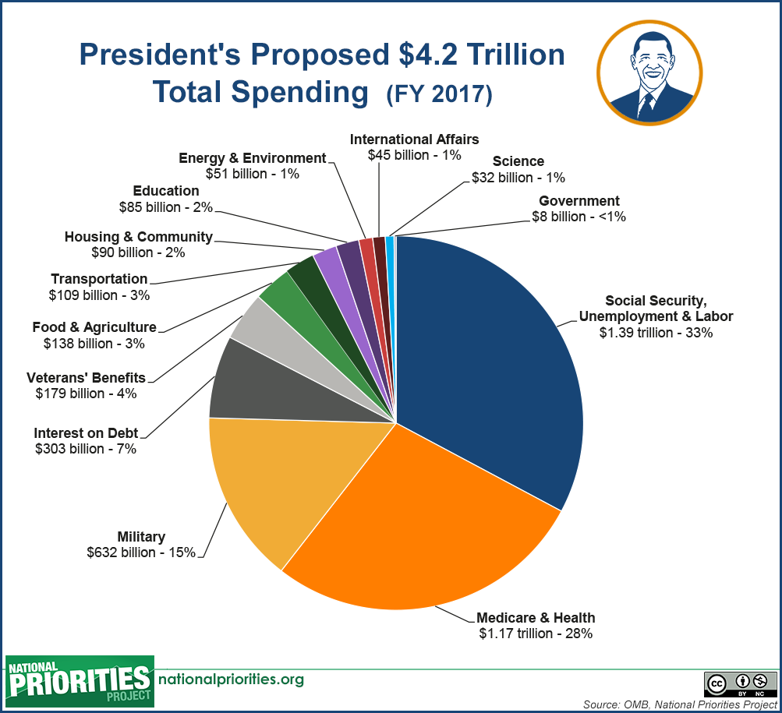

Slide 11
