Slide 1
Financial Institutions
Unit 5

Slide 2
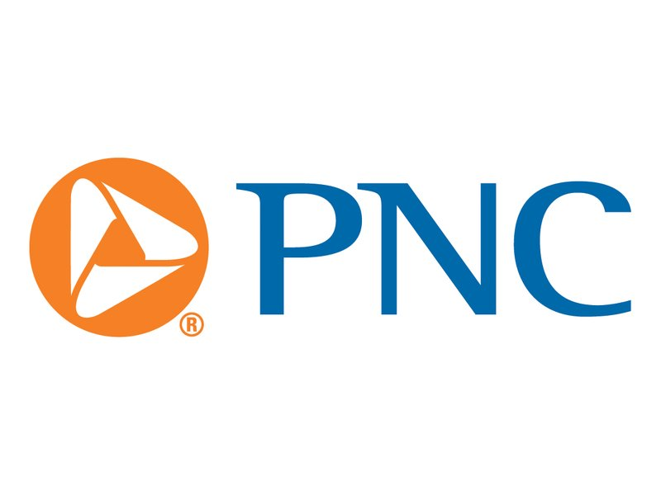
Banks
For most consumers, banks provide a safe means to store earnings. Typically, banks also offer direct deposit (where a person’s paycheck goes directly into his or her account), check-writing services, debit and credit cards, loans of all sorts (personal, home equity, business), and a host of other services.

Slide 3
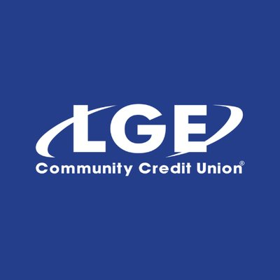
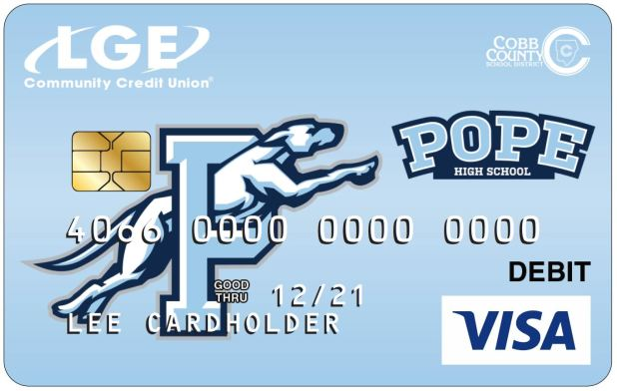
Credit Unions
Credit unions provide services similar to a bank; the main difference is that a credit union only provides these services to its members. Members own and control the institution. Credit unions often offer higher interest rates on deposits and lower interest rates on loans than banks.

Slide 4
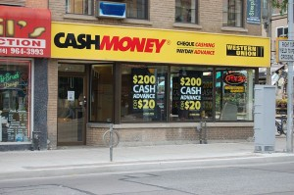
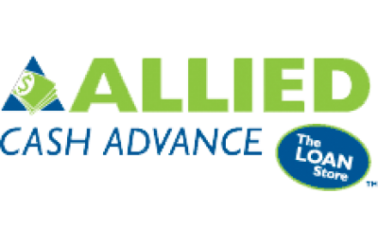
Payday Loan Company
Suppose you need $50 on Wednesday but won’t get paid by your job until Friday. To solve this temporary problem, a payday loan company will give out small loans in return for a portion of the upcoming paycheck. This means the person will get $50 on Wednesday, but come Friday, $55 of his or her paycheck will go to the payday loan company. Payday loan companies generally charge much higher interest on loans than other institutions.

Slide 6
Title Pawn lender
– Title pawn lenders provide short-term loans to individuals facing a gap between their income and expenses. Usually, those accessing loans through title pawn lenders lack access to other types of short-term loans like credit cards.
Title pawn lenders make loans based on an individual’s collateral. Collateral is an item of value one owns like a car. Lenders can sell the collateral to cover the value of an outstanding loan if the borrower cannot repay. Like payday loans, the fees associated with title pawn loans are usually much higher than those a bank would charge. In the case of title pawn loans, the inability to repay the loan could result in the loss of the vehicle put up as collateral.

Slide 7
Banks: Spread between interest charged and interest earned
Interest Earned (Savings)
3%
Interest Charged (Loan)
7%
Profit for the Bank= 4%

Slide 8
Savings Accounts
- Savings accounts are bank accounts in which people put savings to which they need easy access. The Federal Deposit Insurance Corporation (FDIC) most types of bank deposits up to $250,000.
RISK- no risk that the depositor will lose his or her money. The only risk comes from inflation risk. This means that the interest earned on the savings is less than the rate of inflation.
RETURN- Money held in a very low interest savings account is likely to erode in value over time. Since savings accounts are very low risk, the rate of return is very low as well. Most bank pay less than 1% interest on savings.

Slide 9
Certificates of deposit
Certificates of Deposit (CDs) are products offered by banks. Buying a CD means you will earn a higher rate of return than on a regular savings account.
RISK- low risk (However don’t increase interest rate once locked in)
RETURN The higher rate of return results from the saver agreeing to keep the funds in the CD for a specified period, usually between 1 months to 10 years. The longer the period, the higher the interest rate. People who save in CDs and need to withdraw their funds early will pay a fee for early withdrawal.

Slide 10
Retirement accounts
Most retirees will need to live off their savings to maintain their standard of living.
401K- Provided through employer in which most companies match funds
Traditional IRA- allows contributors to put money away before taxes are paid. The taxes are paid on the money when it is withdrawn during retirement
Roth IRA- allow contributors to pay taxes today and withdraw the funds they contributed tax-free in the future. The contributor will still have to pay taxes on any “gaines” they withdraw from their account in retirement
RISK/Reward - All have options for high risk; high reward or low risk low return

Slide 11
U.s. treasury bonds
Purchasing a U.S. Treasury Bond means you have loaned the U.S. government money. The government pays you a guaranteed rate of return.
Return- the rate of return is low.
Risk- Low
For example, the interest rate on a 5-year treasury bond on April 27, 2017 was 1.822%. The interest rate on 10-year treasury bonds was 2.3%. Bonds are safe but also carry an inflation risk if interest paid is not higher than the inflation rate.

Slide 12
Mutual funds
Mutual funds provide more protection against loss because the investment is spread across many different companies rather than just one company. You may also select funds that reflect specific levels of risk or your values.
Long term investing tends to give a greater return in the stock market than short-term investing. Over a 20-year period, the stock market returns on average 7-8%. However, when holding stocks for only 5 to 10 years, the average rate of return drops to 1- 2%.

Slide 13
Stock
Purchasing stock of individual companies is one of the more risky ways to invest. When purchasing stock in large stable companies (blue chip stocks), your investment could be safer, but your rate of return is likely to be lower. If you invest in companies with a shorter history or a brand new product, the potential return is generally high if the company succeeds, but you are much more likely to lose your investment because of the high rate of new business failures.

