Slide 1
Federalists vs Anti-Federalists

Slide 2
Federalist 10
1. How does Madison describe a faction?
2. Why does Madison say you cannot remove the causes of faction?
3. What does he say is the oldest and most common faction?
4. Why do we not need to worry about a minority faction?
5. Why is a majority faction dangerous?
6. What form of government does Madison advocate?
7. How will this type of government control factions?
8. Why does he advocate for elected representatives?

Slide 3
BRUTUS NO. 1
Today, opinions differ over the appropriate size, scope, and power of the federal government. Regardless of personal views, it is hard to deny that Brutus makes several compelling arguments highlighting the potential dangers of a large national government.
1. Which form of government (a large national republic or a confederation of small republics) is more
likely to preserve and protect personal liberties and why?
2. Can a larger republic, based on the principle of consent of the governed, sufficiently protect the rights
and liberties of the individual states and people, or is a confederation the only method of securing such
liberty?
3. Should the federal legislature be able to repeal state laws in order to impose federal laws for the purpose of promoting the general welfare or common defense of the nation? If so, why? If not, why not?
4. Brutus argues that in a republic, “the manners, sentiments, and interests of the people should be
similar…if not, there will be a constant clashing of opinions and the representatives of one part will be
constantly striving against the other.” Should a republic be made up of a small group of like-minded
people? Or, is diversity of opinion beneficial to the success of a federal government?

Slide 4
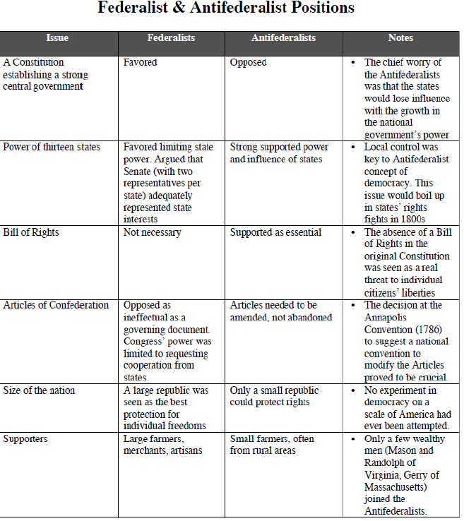

Slide 5
