Slide 1
Lesson 33
UNDERSTANDING THE BUREAUCRACY

Slide 2
THE CONSTITUTION AND BUREAUCRACY
The Constitution made little mention of a bureaucracy
“All other officers of the United States whose appointments are not herein otherwise provided for, and which shall be established by law" (Article II, Section 3)
No provisions mentioned departments or bureaus, but Congress created the first bureaucracy during George Washington’s presidency

Slide 3
FROM SPOILS TO MERIT
“To the victor belong the spoils” (1828)
The spoils system or patronage, started by Andrew Jackson, was used for filling federal jobs
President rewarding supporters with jobs based on service, not on merit
Creation of the Pendleton Act (1883)
Eliminated the spoils system (patronage); created merit system
An exam-based merit system would be used to fill government jobs
Civil Service Commission was created to administer these exams
Hatch Act (1939)
Political activities of bureaucrats are limited
Civil Service Reform Act (1978)
Abolished the U.S. Civil Service Commission
Created the OPM (Office of Personnel Management) to provide guidance to agencies of the executive branch

Slide 4
THE MODERN BUREAUCRACY
A bureaucracy is a large, complex organization of appointed, not elected, officials.
LARGE: Three million civilian federal employees
Department of Defense is the largest department = about 50% (even without active military which is about 1.4 million)
Post Office has about 28%
<10% of top-level jobs are appointed (political appointees) by the president >> PATRONAGE
>90% of federal employees are civil service workers >> MERIT SYSTEM
Tenure protection, difficult to fire (unless appointed by president)
Specialized units with expertise in a field

Slide 5
POWER OF THE BUREAUCRACY
Implementation and Discretionary authority
Carry out laws of Congress, executive orders of the president
Agencies have power to set specific guidelines when receiving a general mandate from Congress
Congress gives them the bones, bureaucracy adds the meat
Regulation
Issue rules and regulations that impact the public and that the private sector must follow (EPA sets clean air standards); Labels on food, emissions of cars, etc.
Administrative Law
Rules and regulations created by an agency that have the effect of law
Helping Congress draft legislation
Providing advice to the White House
Settling disputes

Slide 6
FEDERAL AND STATE EMPLOYEES
Federal government employees currently account for 3 percent of all civilian jobs
The number of federal government employees has remained constant since 1950
The number of state and local government employees has steadily increased since 1950
Block grants have contributed to the widening gap between the number of federal and state employees by shifting resources from the federal government to states and local governments
Federal mandates have also shifted more responsibility to states, causing an increase in the number of their public employees

Slide 7
THE ORGANIZATION OF THE BUREAUCRACY
Agencies of the executive branch may be organized into four basic types:
Cabinet departments
Independent regulatory agencies or commissions
Government corporations
Independent executive agencies

Slide 8
THE CABINET DEPARTMENTS
Article 2, Section 2, Clause 1:
The President . . . may require the Opinion, in writing, of the principal Officer in each of the executive Departments, upon any Subject relating to the Duties of their respective Offices
Each of the fifteen cabinet departments is headed by a secretary, except for the Department of Justice, which is headed by the Attorney General
All of the heads are chosen by the President and confirmed by the Senate
Manage a specific policy area with responsibility further divided among various agencies
Secretaries often develop a strong loyalty to their departments. They become closer to the department than to the President.

Slide 9
THE CABINET DEPARTMENTS
The fifteen cabinet departments, in order of creation, are:
State (1789) - advises the president on foreign policy, negotiates treaties, represents the United States in international organizations
Treasury (1789) - collects federal revenues, pays federal bills, mints coins and prints paper money, enforces alcohol, tobacco and firearm laws
Defense (1789) - manages the armed forces, operates military bases
Interior (1849) - manages federal lands, refuges, and parks, operates hydroelectric facili­ties, manages Native American affairs
Justice (1870) - provides legal advice to the president, enforces federal laws, represents the United States in court, operates federal prisons

Slide 10
THE CABINET DEPARTMENTS
The fifteen cabinet departments, in order of creation, are:
Agriculture (1889) - provides agricultural assistance to farmers and ranchers, inspects food, manages national forests
Commerce (1903) - grants patents and trademarks, conducts the national census, pro­motes international trade
Labor (1913) - enforces federal labor laws (child labor, minimum wage, safe working con­ditions), administers unemployment and job training programs
Health and Human Services (1953) - administers Social Security and Medicare/Medic­aid Programs, promotes health care research, enforces pure food and drug laws
Housing and Urban Development (1965) - provides home financing and public housing programs, enforces fair housing laws

Slide 11
THE CABINET DEPARTMENTS
The fifteen cabinet departments, in order of creation, are:
Transportation (1967) - promotes mass transit programs and programs for highways, rail­roads, and air traffic, enforces maritime law
Energy (1977) - advances the energy security of the U.S. and takes care of the nation’s nuclear security
Education (1979) - administers federal aid programs to schools, engages in educational research
Veterans Affairs (1989) - promotes the welfare of veterans of the armed forces
Homeland Security (2002) - prevents terrorist attacks within the United States, reduces America's susceptibility to terrorism, minimizes damage and helps recovery from attacks that do occur

Slide 12
THE INDEPENDENT REGULATORY AGENCIES
Agencies (also known as independent regulatory commissions) are created by Congress
Regulate important parts of the economy
Make rules for large industries and businesses that affect the interests of the public
Since regulatory agencies are watchdogs that by their very nature need to operate independently, they are not part of a department
Small commissions govern the regulatory agencies
Five to ten members appointed by the president and confirmed by the Senate
Commissioners are somewhat more "independent" than are the cabinet secretaries because they cannot be removed by the president during their terms of office
Commissioners serve rather long terms (5-14 years)
Terms of the commissioners are staggered
These factors help to insulate regulatory commissions from political pressure
Commissions have quasi-legislative powers because they have the authority to make rules and regulations that have the force of law
Commissions also have quasi-judicial powers because they can settle disputes in their fields (such as the FCC fining Howard Stern for objectionable material that was broadcast on his radio program)

Slide 13
THE INDEPENDENT REGULATORY AGENCIES
Examples:
Federal Communications Commission (FCC)
Regulates all communications by telegraph, cable, telephone, radio, and television.
The Federal Trade Commission (FTC)
Prevents businesses from engaging in unfair trade practices; stops the formation of monopolies in the business sector; protects consumer rights.
Federal Election Commission (FEC)
Administers and enforces the Federal Election Campaign Act (FECA); discloses campaign finance information and oversees the public funding of presidential elections.
The Securities and Exchange Commission (SEC)
Regulates the nation’s stock exchanges; requires full disclosure of the financial profiles of companies that wish to sell stocks to the public.
The Federal Reserve Board (The Fed)
Establishes monetary policy >> refers to the money supply and interest rates.
Monetary policy = controlling the money supply. Fiscal policy = taxing and spending.
Sets bank interest rates; controls inflation; regulates the money supply; adjusts banks reserve requirements.

Slide 14
THE GOVERNMENT CORPORATIONS
Blend of private corporations and government agency.
Created to allow more freedom and flexibility than exists in regular government agencies.
Have more control over their budgets, and often have the right to decide how to use their own earnings.
Since the government still ultimately controls them, they do not operate like true private corporations.
Examples:
The U.S. Postal Service - The post office is a corporation that competes with private services.
National Railroad Passenger Corporation (AMTRAK) - Congress created Amtrak to provide railroad passenger service that is heavily subsidized by the federal government. Part of the motivation for its creation was the lack of private companies providing the service, and Amtrak has suffered some huge financial losses. Recently, in an attempt to make the corporation more profitably, Congress has allowed Amtrak to drop some of its less popular routes.
The Corporation for Public Broadcasting - This controversial government corporation still operates public radio and television stations. Although largely funded by private donations, the government still provides policies and money to support their programs.

Slide 15
INDEPENDENT EXECUTIVE AGENCIES
Agencies that do not fall into the first three categories.
Closely resemble Cabinet departments, but they are smaller and less complex
Generally, they have narrower areas of responsibility than do cabinet departments.
Most are subject to presidential control and are independent only in the sense that they are not part of a department.
Their main function is not to regulate, but to fulfill a myriad of other administrative responsibilities.
Examples:
Central Intelligence Agency - The CIA is responsible for providing national security intelligence to senior US policymakers.
Environmental Protection Agency - The EPA was established to consolidate in one agency a variety of federal research, monitoring, standard-setting and enforcement activities to ensure environmental protection.
The National Aeronautics and Space Administration - NASA administers the United States space program, financing ventures into space since 1958.

Slide 16
Lesson 34
CONTROLLING THE BUREAUCRACY

Slide 17
CONTROLLING THE BUREAUCRACY CONGRESSIONAL INFLUENCE
Congress has a great amount of power over the bureaucracy because Congress can exercise LEGISLATIVE OVERSIGHT.
What are the numerous ways in which Congress can exercise “oversight” of the bureaucracy?
Creation of agencies
Constitutional power to create and abolish executive departments and independent agencies, or to transfer their functions
Advice and consent
Congress can influence the appointment of agency heads
The Senate has the power to confirm presidential appointments
Appropriations of agency budgets
Congress determines how much money each agency gets
Annual authorization legislation
No agency may spend money unless it has first been authorized by Congress
Authorization legislation originates in a congressional committee and states the maximum amount of money that an agency may spend on a given program
Even if funds have been authorized, Congress must also appropriate the money
Rewriting legislation
If they wish to restrict the power of an agency, Congress may rewrite legislation or make it more detailed
The more detailed the instructions, the better able Congress is to restrict the agency's power

Slide 18
CONTROLLING THE BUREAUCRACY CONGRESSIONAL INFLUENCE
Congress has a great amount of power over the bureaucracy because Congress can exercise LEGISLATIVE OVERSIGHT.
What are the numerous ways in which Congress can exercise “oversight” of the bureaucracy?
Duplication
Giving any one job to more than one agency, keeping any single agency from becoming all powerful
For example, drug trafficking is the task of the Customs Services, the FBI, the DEA, the Border Patrol, and the Department of Defense
Keeps any one agency from becoming all-powerful
Holding hearings and conducting investigations
Congress can call bureaucrats to testify before committees and subcommittees to determine whether the agency is complying with congressional intent
Congress can investigate agencies
Reorganization
By realigning or restructuring departments, agencies and their responsibilities, Congress can contain costs, reduce bureaucratic overlap and improve accountability.
Sunset laws
Provides for the law to cease to have effect after a specific date, unless further legislative action is taken to extend the law
Sunset laws create a finite lifespan for a bureaucratic agency
In order to be reauthorized, these bureaucracies must prove their effectiveness and merit

Slide 19
CONTROLLING THE BUREAUCRACY CONGRESSIONAL INFLUENCE?
What are the limits on congressional influence?
Congress may not really want to clamp down on the bureaucracy:
Members profit politically from the existence of federal programs within their states or districts (e.g., military base closure)
Easier for Congress to simply pass broadly worded laws and have experts within the bureaucracy fill in the holes
No electoral payoff; Political ramifications
Oversight is labor intensive/hard work; Lack of technical expertise
Congress creates opportunities for casework through red tape
Congress lacks expertise/agencies have expertise
Congress does not want to be blamed for bad policy
Time-consuming

Slide 20
CONTROLLING THE BUREAUCRACY PRESIDENTIAL INFLUENCE
Appointments
Appointment of top-level bureaucrats (including Cabinet secretaries)
Fire top-level bureaucrats (including Cabinet secretaries)
Executive Orders
An executive order is a directive, order, or regulation issued by the president
An executive order of the President must find support in the Constitution, either in a clause granting the President specific power, or by a delegation of power by Congress to the President
Economic Powers
Proposes agency budgets (either an increase or a decrease in $)
Other Powers
Propose the reorganization of the executive branch
Presidential power of influence over different agencies direction
What are the limits on presidential influence?
Senate confirmation needed for top personnel
President cannot fire vast majority of bureaucrats
Reorganization must go through Congress
Agency budgets must go through Congress

Slide 21
CONTROLLING THE BUREAUCRACY COURT AND INTEREST GROUP INFLUENCE
COURTS AND THE BUREAUCRACY
Powers
Court rulings that limit bureaucratic practices
Judicial review - can declare bureaucratic actions unconstitutional
Injunctions (a judicial order that restrains a person/group from beginning or continuing an action threatening or invading the legal right of another) against federal agencies
INTEREST GROUPS AND THE BUREAUCRACY
Powers
Lobbying
“Revolving door” - Agencies are staffed by people who move back and forth between the public/private sector
Client groups
Some agency-interest group relations are so close that the interest group is said to be a client of the agency (e.g., dairy groups and Agriculture Dept)
Iron triangles: congressional committee, relevant agency, related interest groups
Issue networks: informal groups of people within both the public/private sectors who have common interests
Agency employees are recruited from the regulated industry (vice versa)
Agencies rely on support from regulated industries in making budget requests
Litigation: Take a bureaucratic agency to court

Slide 22
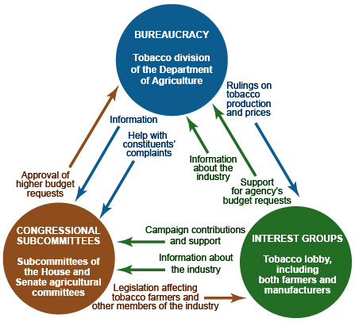
IRON TRIANGLES vs. ISSUE NETWORKS
IRON TRIANGLES
Definition: Alliances among bureaucrats, interest groups, and congressional subcommittee members and staff sometimes form to promote their common causes. Also known as subgovernments.

Slide 23
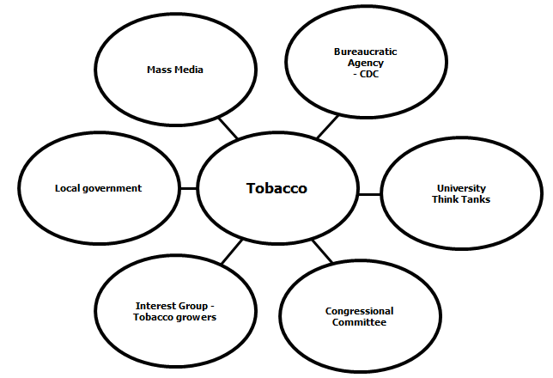
IRON TRIANGLES vs. ISSUE NETWORKS
ISSUE NETWORKS
Definition: Network that consists of people in interest groups, on congressional staffs, in bureaucratic agencies, in universities, and in the mass media who regularly debate an issue.

