Slide 1
3 Common Tax Types:
Income | Amount of Tax | % of Income Paid in Tax
$50,000 | $2,500 | 5%
$75,000 | $5,625 | 7.5%
$100,000 | $10,000 | 10%
Progressive tax- requires a larger percentage of income paid in tax from high-income earners than it does from low-income earners
Regressive tax- requires a larger percentage of income paid in tax from low-income earners than from high-income earners.
Proportional tax- requires the same percentage of a person’s income; tax is levied from all taxpayers, regardless of their income amount.
Income | Amount of Tax | % of Income Paid in Tax
$50,000 | $15,000 | 30%
$75,000 | $15,000 | 20%
$100,000 | $10,000 | 10%
Income | Amount of Tax | % of Income Paid in Tax
$50,000 | $5,000 | 10%
$75,000 | $7,500 | 10%
$100,000 | $10,000 | 10%

Slide 2
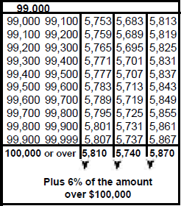
Common Taxes in Georgia
The individual income tax is a progressive tax on a portion of the income a person or a married couple earns in salaries, wages, or investments.
The individual income tax is Georgia's top revenue source, generating between 40 and 45 percent of the state's total revenue
Notes:
The chart represents what a household with $99,000-$99,999 of annual income would pay in income tax in Georgia for the 2016 fiscal year. The numerical values in the three columns to the right of the income level corresponds with the amount of income tax owed to the state. (Mathematical note: married filing separately, $5813/$99,100= 5.865%; $5867/$99,999= 5.867%...thus, the tax is progressive within each income bracket as well).
Georgia’s #1 source of government revenue is the individual income tax!
Optional: display two copies of the “2016 Georgia Income Tax Table” handout and have students locate their income tax rate as a Single tax filer to discover the progressive nature of income taxes

Slide 3
Common Taxes in Georgia
The general sales tax (or "sales and use tax") is a regressive tax placed on customer purchases of most items bought at retail stores.
The sales tax is a percentage of the price of an item. Georgia has a 4 percent sales tax rate, but because local governments are allowed to add on optional sales taxes, customers may pay up to 7 or 8 percent on retail sales.
The state revenue department collects all of the sales-tax revenue and returns the local portion to the appropriate counties, cities, and school systems.
Sales taxes are the 2nd leading tax source in GA generating about 30% of state revenues
Notes:
Some retail items, especially most food products, have been exempted from the state sales tax. Before exemptions for food items were enacted, the sales tax was the leading tax source in Georgia; now, it is second, usually generating about 30 percent of the state's revenues.
Sales taxes are regressive because they impact lower income earners more than higher income earners!
Digby, Michael F. "State Revenues in Georgia." New Georgia Encyclopedia. 03 August 2016. Web. 09 May 2017.
http://www.georgiaencyclopedia.org/articles/government-politics/state-revenues-georgia

Slide 4
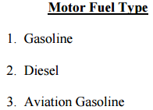
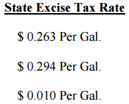
Common Taxes in Georgia
Excise taxes are sales taxes (a regressive tax) placed on the purchase of such items as gasoline, alcoholic beverages, and tobacco products.
Excise taxes are usually fixed amounts per item rather than percentages of the price.
The motor-fuel tax is the largest excise tax, contributing about 4 to 5 percent of state revenues. The Georgia Constitution specifies that the state must spend whatever amount is raised by the motor-fuel tax on roads and bridges.
Notes:
Digby, Michael F. "State Revenues in Georgia." New Georgia Encyclopedia. 03 August 2016. Web. 09 May 2017.
http://www.georgiaencyclopedia.org/articles/government-politics/state-revenues-georgia

Slide 5
Common Taxes in Georgia
The property tax is a proportional tax paid by residential and commercial property owners to fund local public goods such as education and fire protection.
Each county and/or city creates the rate at which properties are taxed. Therefore, the assumption is that people pay a proportional percentage of their property’s value.
Notes:
Property taxes are calculated using a millage rate and 40% of the market value of a home or property. See Teacher Background notes for details about millage rate and property tax assessment and collection.

